Slide 1
Logistic regression for binary outcomes
蒋智超
2025年 秋

Slide 2
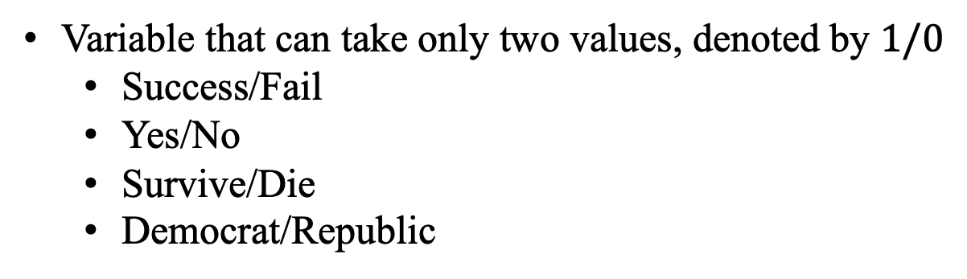
Binary outcome
Variable that can take only two values, denoted by $1/0$
Success/Fail
Yes/No
Survive/Die
Democrat/Republic

Slide 3


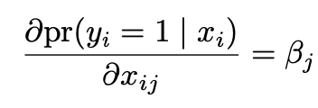

Binary outcome
For simplicity, we can still use the linear model for a binary outcome
Linear probability model
Easy interpretation
Heteroskedasticity
Not natural for binary outcome because probability is bounded between
zero and one

Slide 4

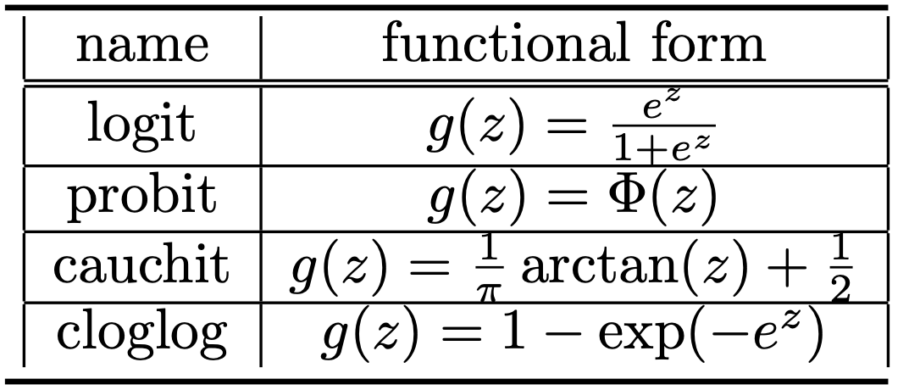
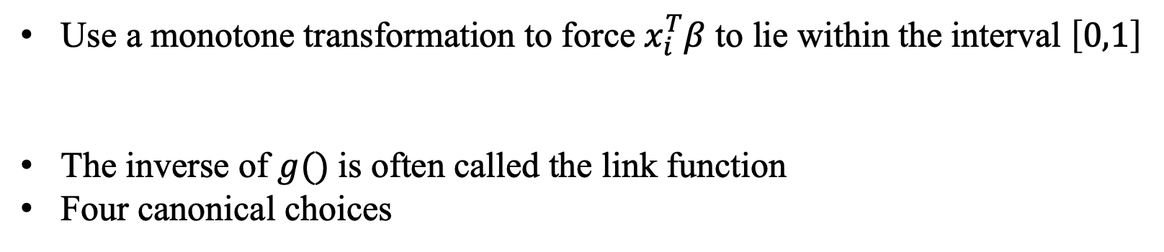
Link functions
Use a monotone transformation to force $x_{i}^{T}β$ to lie within the interval $\left[0,1\right]$
The inverse of $g()$is often called the link function
Four canonical choices

Slide 5
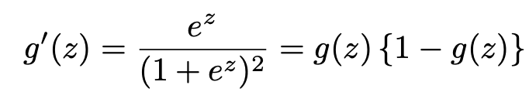
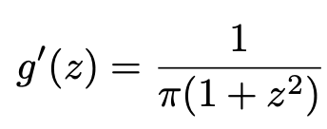

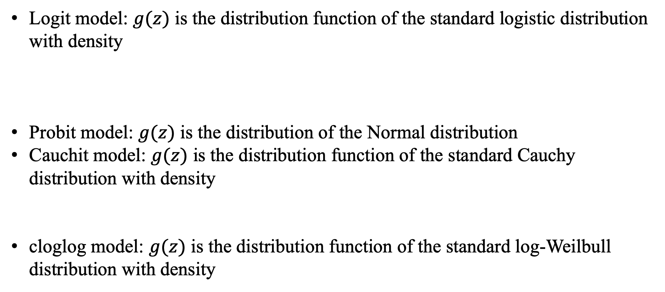
Link functions
Logit model: $g(z)$ is the distribution function of the standard logistic distribution with density
Probit model: $g(z)$ is the distribution of the Normal distribution
Cauchit model: $g(z)$ is the distribution function of the standard Cauchy distribution with density
cloglog model: $g(z)$ is the distribution function of the standard log-Weilbull distribution with density

Slide 6
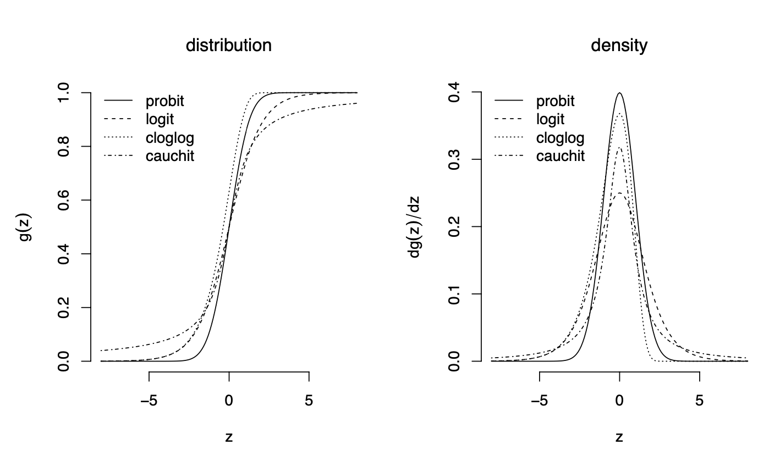
Link functions
Notes:
The distribution functions are quite similar for all links, but the density for cloglog is asymmetric although all other three densities are symmetric.

Slide 7
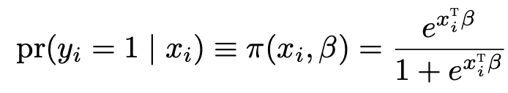
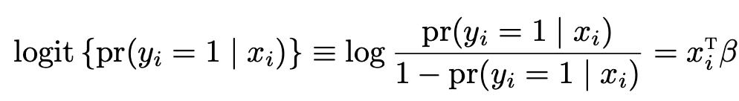
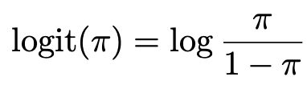
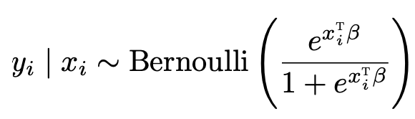
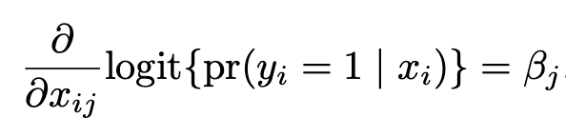
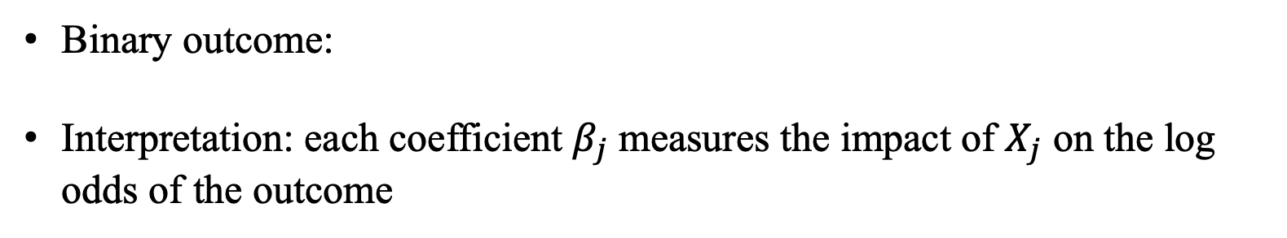
Logit model
Binary outcome:
Interpretation: each coefficient $β_{j}$measures the impact of $X_{j}$ on the log odds of the outcome

Slide 8
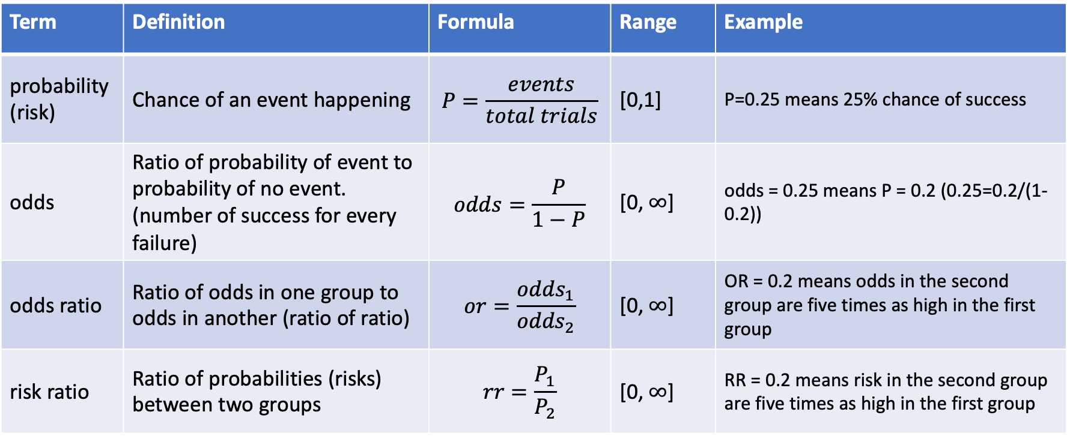
Risk ratio, odds, odds ratio
Term | Definition | Formula | Range | Example
probability (risk) | Chance of an event happening | $$P=\frac{events}{total trials}$$ | [0,1] | P=0.25 means 25% chance of success
odds | Ratio of probability of event to probability of no event. (number of success for every failure) | $$odds=\frac{P}{1−P}$$ | [0, $∞$] | odds = 0.25 means P = 0.2 (0.25=0.2/(1-0.2))
odds ratio | Ratio of odds in one group to odds in another (ratio of ratio) | $$or=\frac{{odds}_{1}}{{odds}_{2}}$$ | [0, $∞$] | OR = 0.2 means odds in the second group are five times as high in the first group
risk ratio | Ratio of probabilities (risks) between two groups | $$rr=\frac{P_{1}}{P_{2}}$$ | [0, $∞$] | RR = 0.2 means risk in the second group are five times as high in the first group

Slide 9
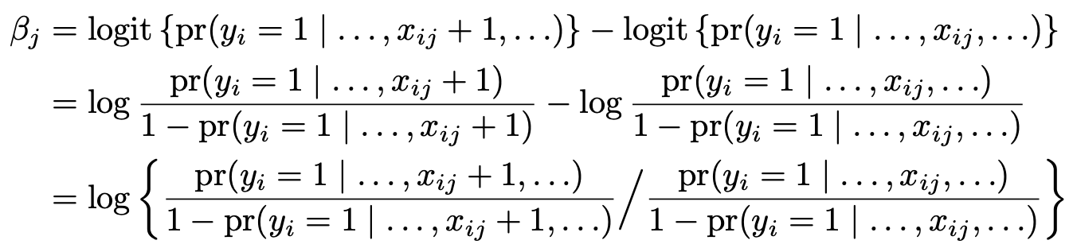

Odds ratio
Epidemiologists also call $β_{j}$ the conditional log odds ratio
If $β_{j}>0$, then larger values of $x_{ij}$ lead to larger probability of $y_{i}=1$
If $β_{j}<0$, then larger values of $x_{ij}$ lead to smaller probability of $y_{i}=1$

Slide 10
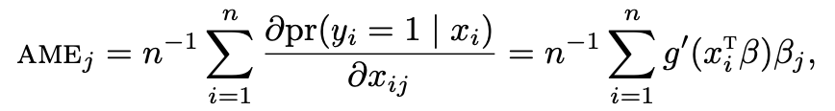
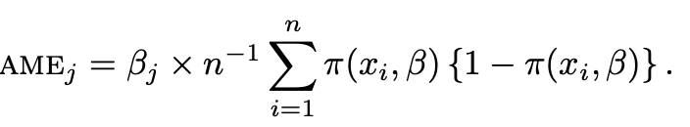
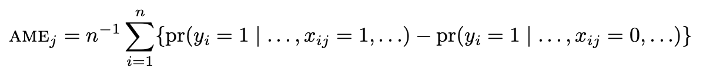
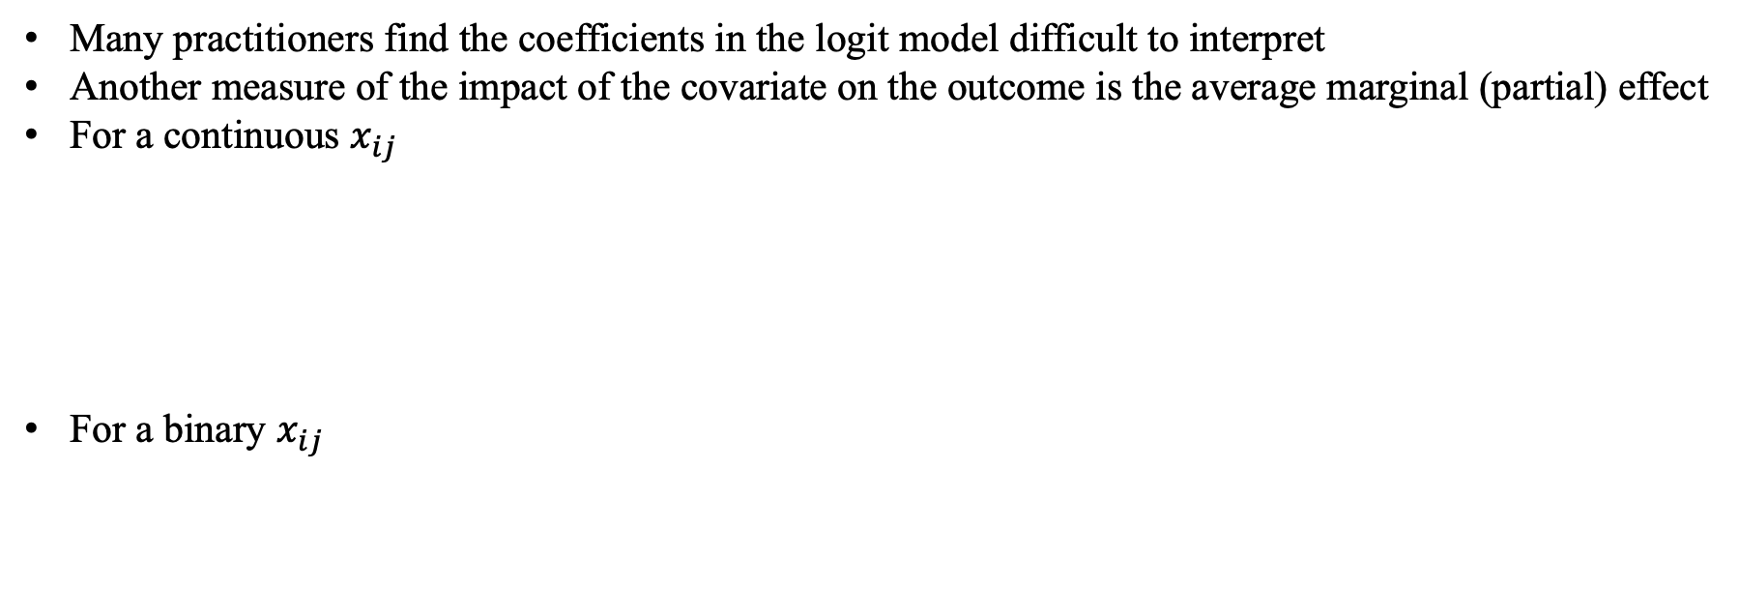
Average marginal effect
Many practitioners find the coefficients in the logit model difficult to interpret
Another measure of the impact of the covariate on the outcome is the average marginal (partial) effect
For a continuous $x_{ij}$
For a binary $x_{ij}$

Slide 11
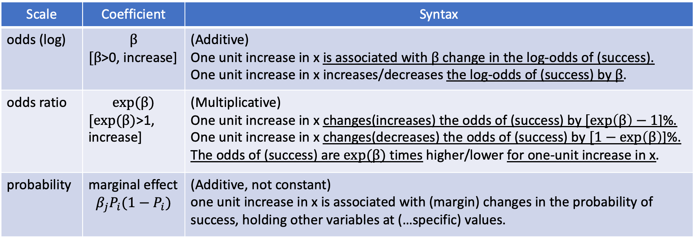
Interpretation
Scale | Coefficient | Syntax
odds (log) | $$β$$ $[β$>0, increase] | (Additive) One unit increase in x is associated with $β$ change in the log-odds of (success). One unit increase in x increases/decreases the log-odds of (success) by $β$.
odds ratio | $$exp⁡(β)$$ $[exp⁡(β)$>1, increase] | (Multiplicative) One unit increase in x changes(increases) the odds of (success) by $[\exp\left(β\right)−1$]%. One unit increase in x changes(decreases) the odds of (success) by $[1−exp\left(β\right)$]%. The odds of (success) are $exp⁡(β)$ times higher/lower for one-unit increase in x.
probability | marginal effect $$β_{j}P_{i}(1−P_{i})$$ | (Additive, not constant) one unit increase in x is associated with (margin) changes in the probability of success, holding other variables at (…specific) values.

Slide 12
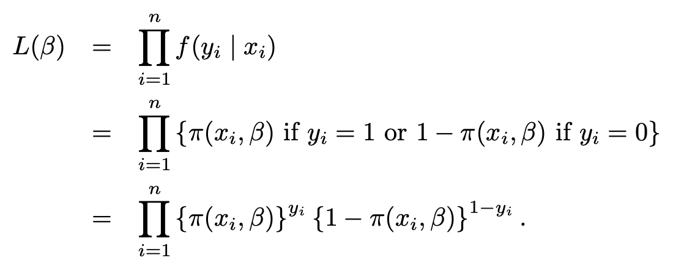
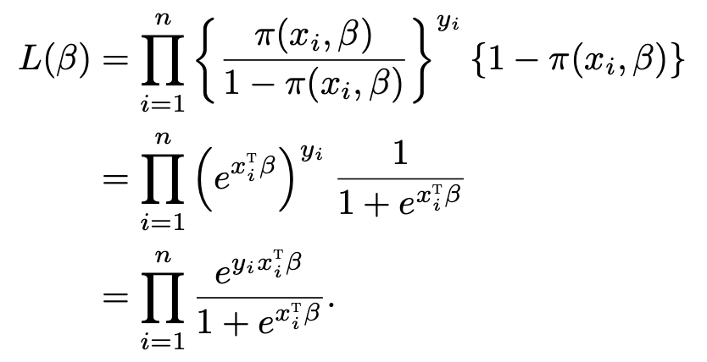
Maximum likelihood estimation

Slide 13
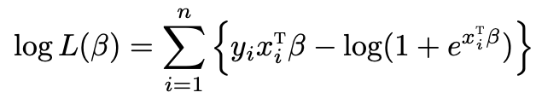
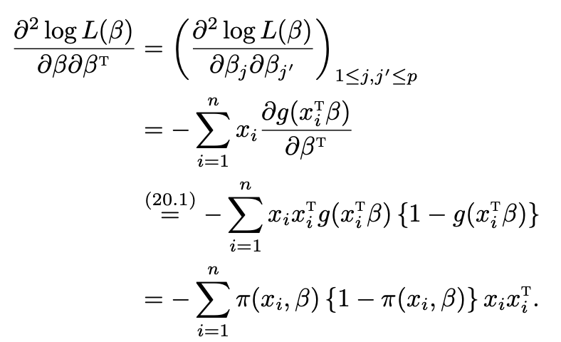
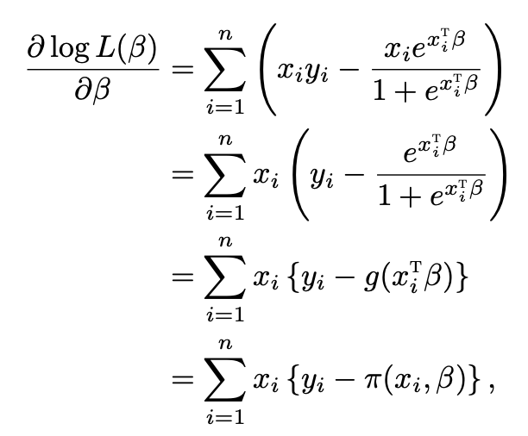
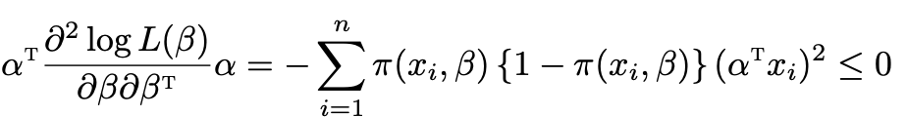
Maximum likelihood estimation

Slide 14
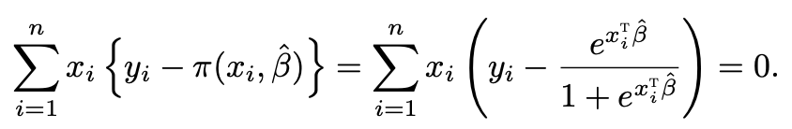
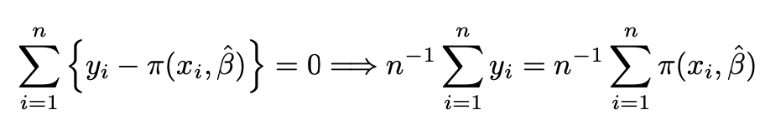
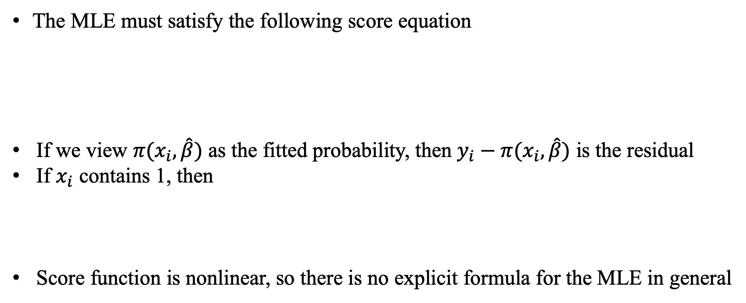
Maximum likelihood estimation
The MLE must satisfy the following score equation
If we view $π(x_{i},\hat{β})$ as the fitted probability, then $y_{i}−π(x_{i},\hat{β})$ is the residual
If $x_{i}$ contains 1, then
Score function is nonlinear, so there is no explicit formula for the MLE in general

Slide 15
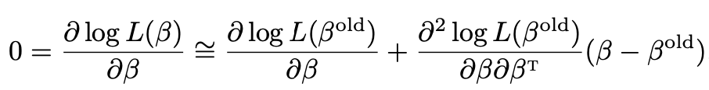
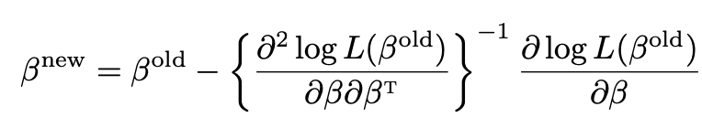
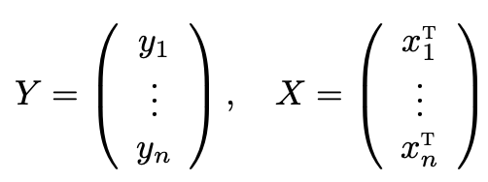
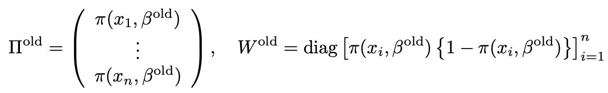
Maximum likelihood estimation
We usually use Newton’s method to solve for it based on the linearization of the score function
Matrix form
Define

Slide 16
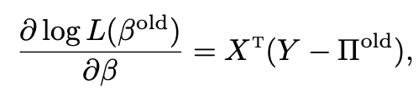
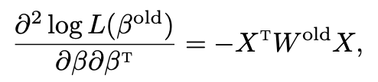
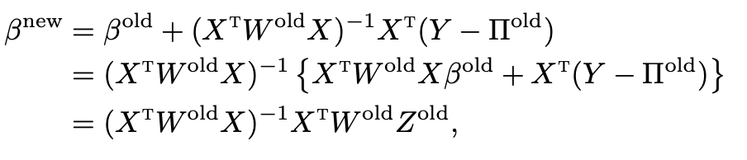
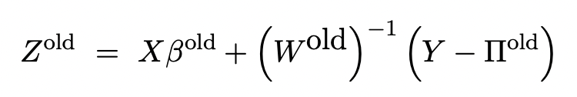
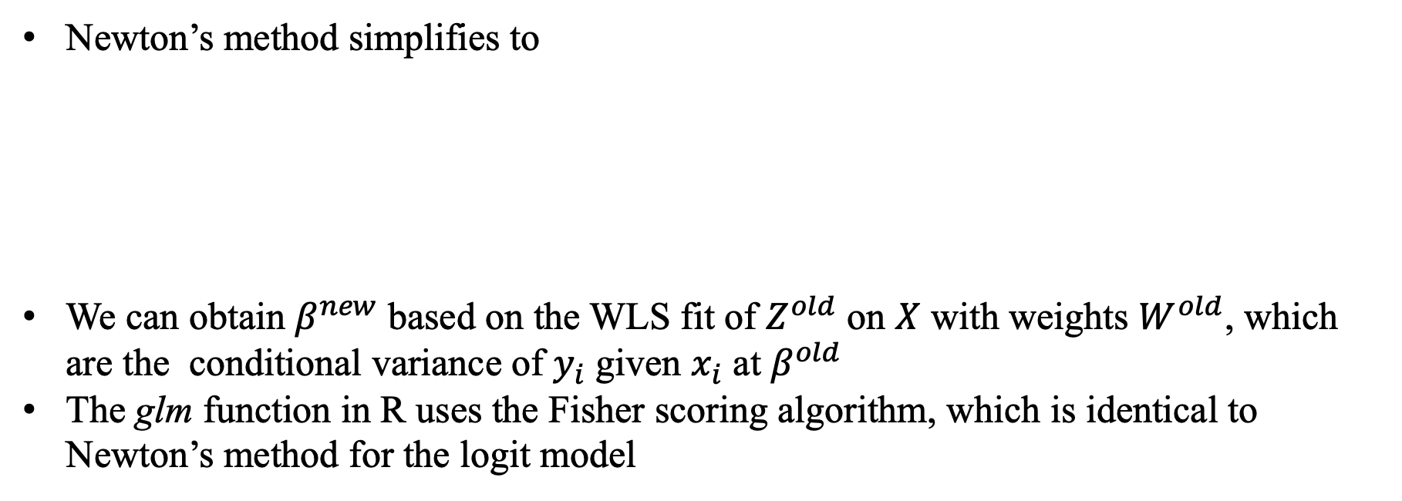
Iteratively reweighted least squares algorithm
Newton’s method simplifies to
We can obtain $β^{new}$ based on the WLS fit of $Z^{old}$ on $X$ with weights $W^{old}$, which are the conditional variance of $y_{i}$ given $x_{i}$ at $β^{old}$
The glm function in R uses the Fisher scoring algorithm, which is identical to Newton’s method for the logit model

Slide 17
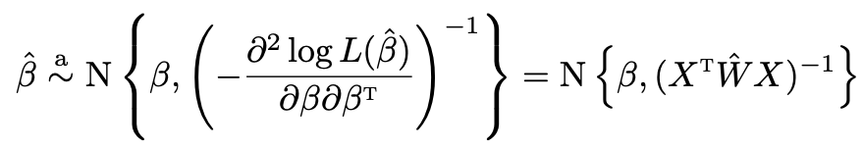

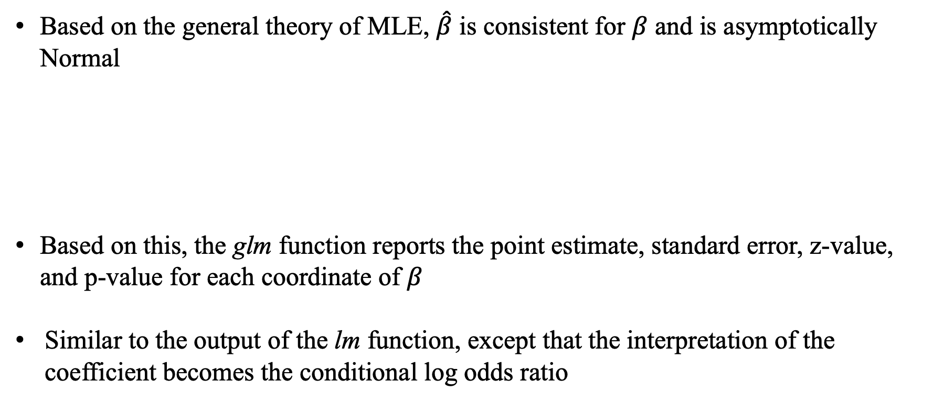
Inference
Based on the general theory of MLE, $\hat{β}$ is consistent for $β$ and is asymptotically Normal
Based on this, the glm function reports the point estimate, standard error, z-value, and p-value for each coordinate of $β$
Similar to the output of the lm function, except that the interpretation of the coefficient becomes the conditional log odds ratio

Slide 18
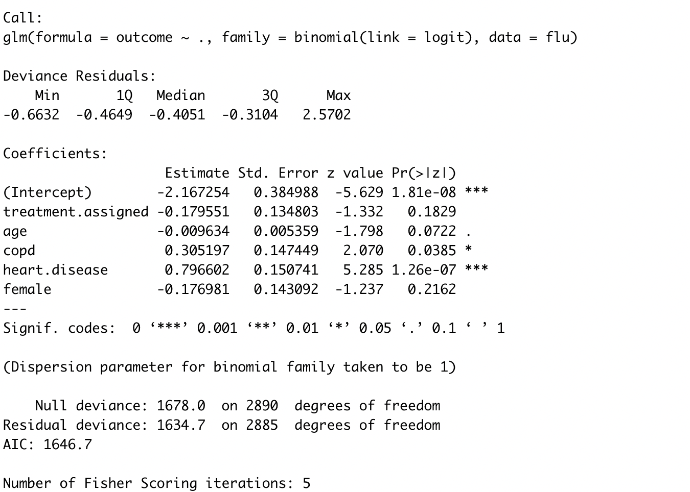
Inference

Slide 19
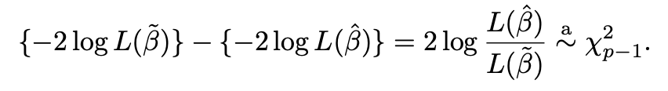
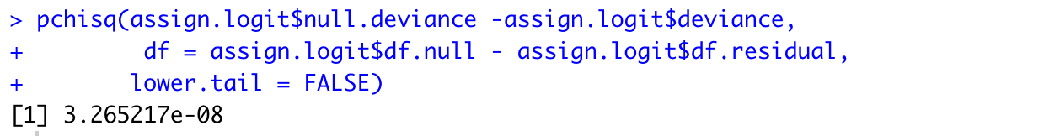
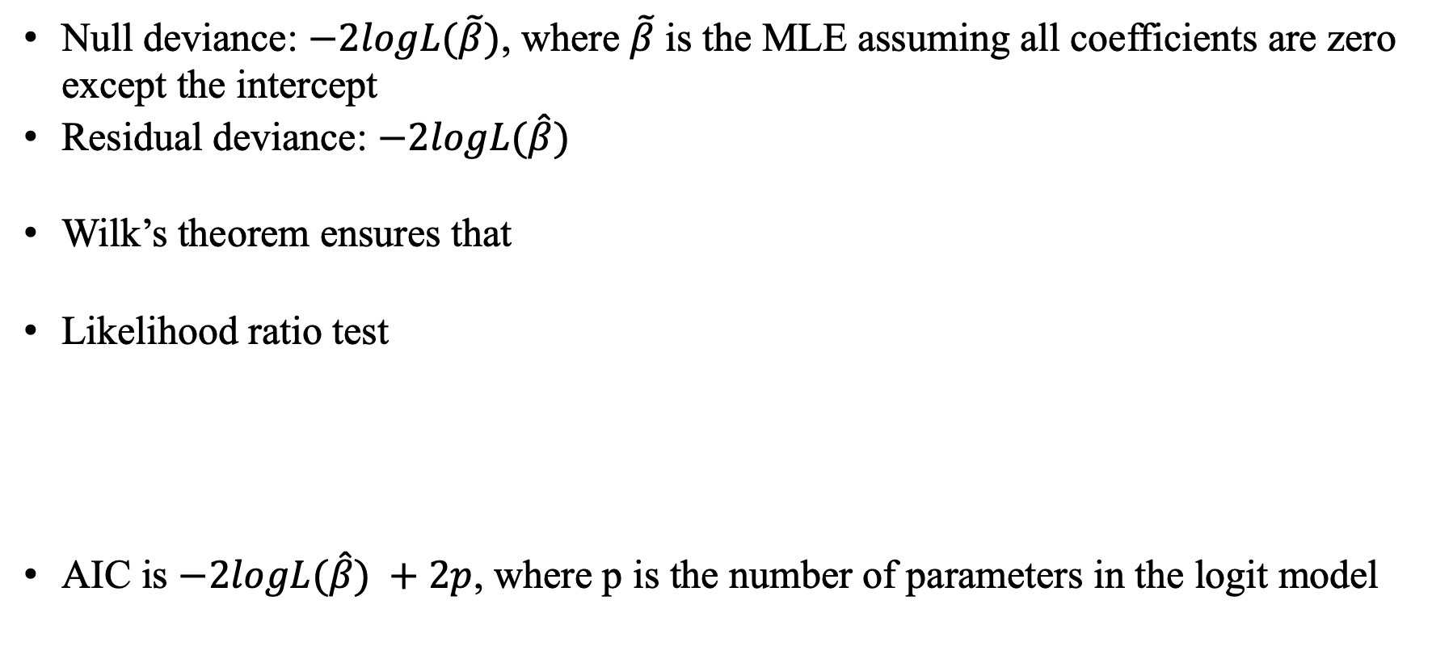
Inference
Null deviance: $−2logL(\tilde{β})$, where $\tilde{β}$ is the MLE assuming all coefficients are zero except the intercept
Residual deviance: $−2logL(\hat{β})$
Wilk’s theorem ensures that
Likelihood ratio test
AIC is $−2logL(\hat{β}) +2p$, where p is the number of parameters in the logit model

Slide 20

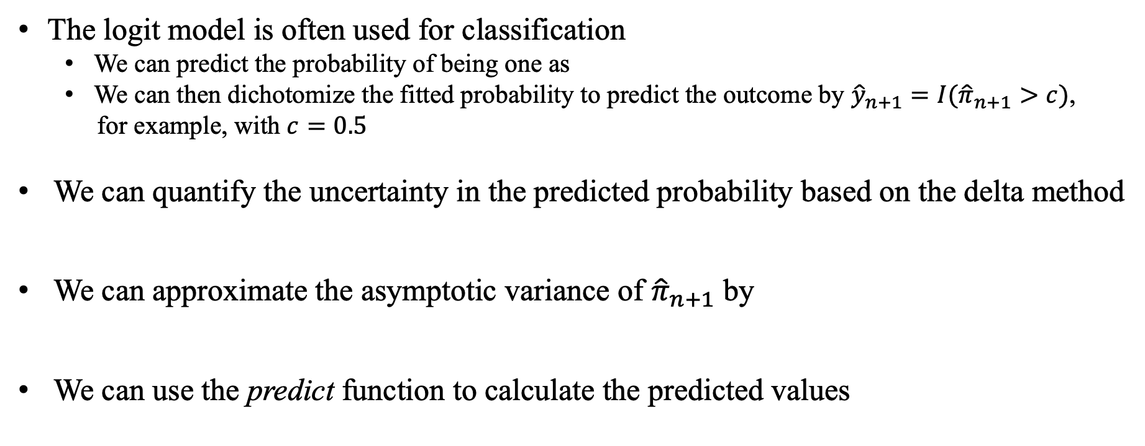
Prediction
The logit model is often used for classification
We can predict the probability of being one as
We can then dichotomize the fitted probability to predict the outcome by ${\hat{y}}_{n+1}=I({\hat{π}}_{n+1}>c)$,
for example, with $c=0.5$
We can quantify the uncertainty in the predicted probability based on the delta method
We can approximate the asymptotic variance of ${\hat{π}}_{n+1}$ by
We can use the predict function to calculate the predicted values

Slide 21
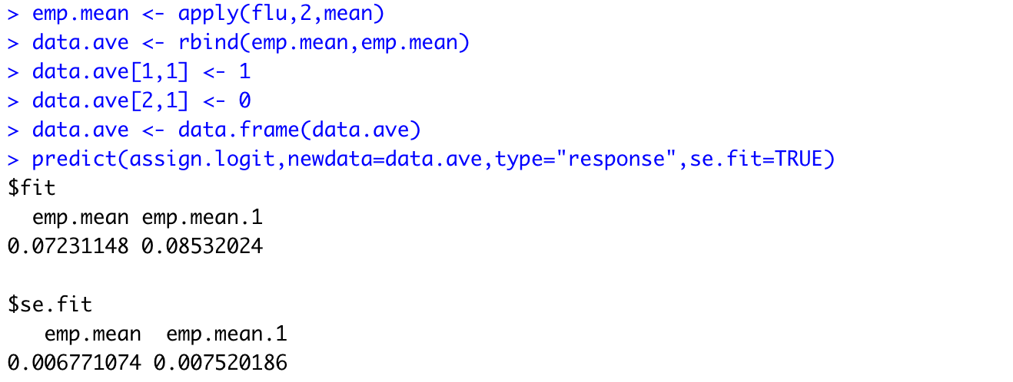
Prediction

Slide 22
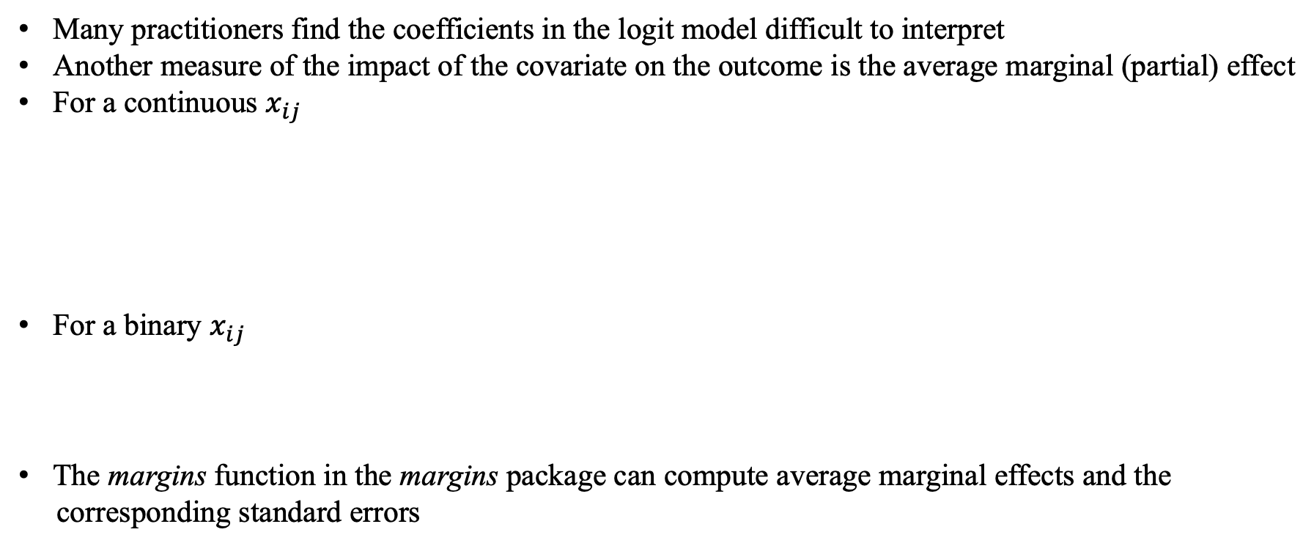
Average marginal effects
Many practitioners find the coefficients in the logit model difficult to interpret
Another measure of the impact of the covariate on the outcome is the average marginal (partial) effect
For a continuous $x_{ij}$
For a binary $x_{ij}$
The margins function in the margins package can compute average marginal effects and the
corresponding standard errors

Slide 23
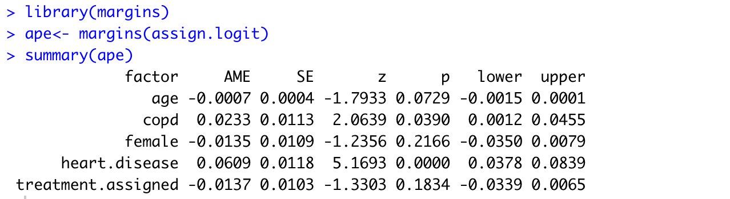
Average partial effects

Slide 24

Does the link function matter?
Generate data from a logistic model
Fit the data with the linear probability model and binary models with four link functions
Estimated coefficients
Notes:
The coefficients are quite different because the coefficients measure the association between x and y on difference scales

Slide 25

Does the link function matter?
Notes:
The patterns are quite similar although the linear probability model can give fitted probabilities outside [0, 1]

Slide 26


Logit and probit
The coefficient from the logit model approximately equals those from the probit model
multiplied by 1.7, a constant that minimizes

Slide 27


Penalized logistic regression
The objective function for the original logit model is the logit model
When $α=1$, it gives the ridge analogue of the logistic regression
When $α=0$, it gives the lasso analogue
When $α∈(0,1)$, it gives the elastic net analogue
The glmpath package uses the coordinate descent algorithm based on quadratic approximation of the log-likelihood
We can select the tuning parameter based on cross-validation
Notes:
一个灌水重灾区是把惩罚项改了，另一个是把前面的MSE改了

Slide 28





Case-control study
The logit model works not only for the cohort study with data from conditional distribution $y_{i}|x_{i}$, but also for the case-control study with data from conditional distribution
We only have the data with $s_{i}=1$ with unknown $p_{1}$ and $p_{0}$
We have where
The model of $y_{i}$ on $x_{i}$ conditional on $s_{i}=1$ is still the logit
We can estimate the slope, but not the intercept
Notes:
Cohort studies recruit and follow participants who share a common characteristic, such as a particular occupation or demographic similarity.
Kagan (2001) showed that the logistic link is the only one that enjoys this property.

Slide 29


Case-control study
Proof: By Bayes’ formula

Slide 30



Latent linear model
The link function can be interpreted as the distribution function of the error term
It is a powerful way to generate models for more complex data

